Slide 1

CLASS 11 : CONTROL STRUCTURES

Slide 2
Introduction: Making Decisions and Repeating Tasks
What are Control Structures
Control structures allow your program to make decisions and repeat tasks. They are the logic and "brain" of your programs.
Two Main Types:
- Conditional Statements: Make decisions (if this, then that)
- Loops: Repeat tasks (do this multiple times)

Slide 3
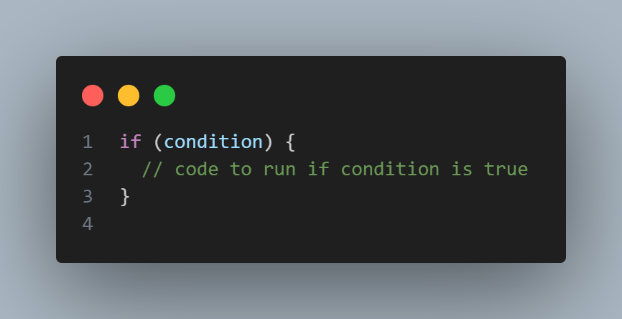
Part 1: Conditional Statements
The ‘if’ Statement
The if statement executes code only if a condition is true.
Syntax:

Slide 4
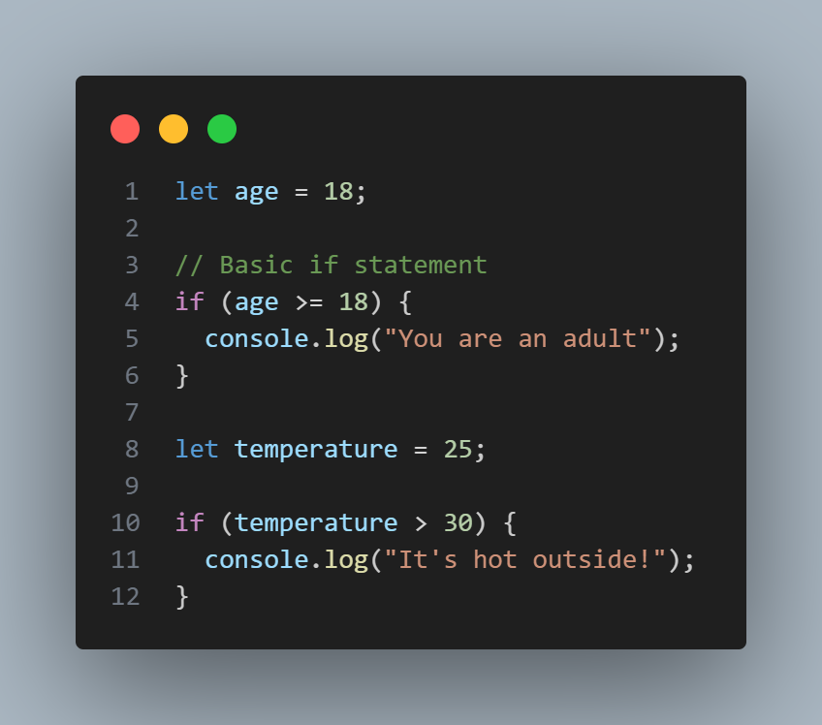
Examples

Slide 5
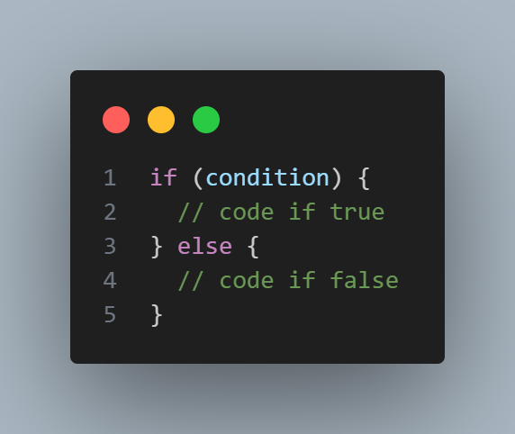
Part 2 cont’d
The ‘if….else’ Statement
Execute one block if condition is true, another if it's false.
Syntax:

Slide 6
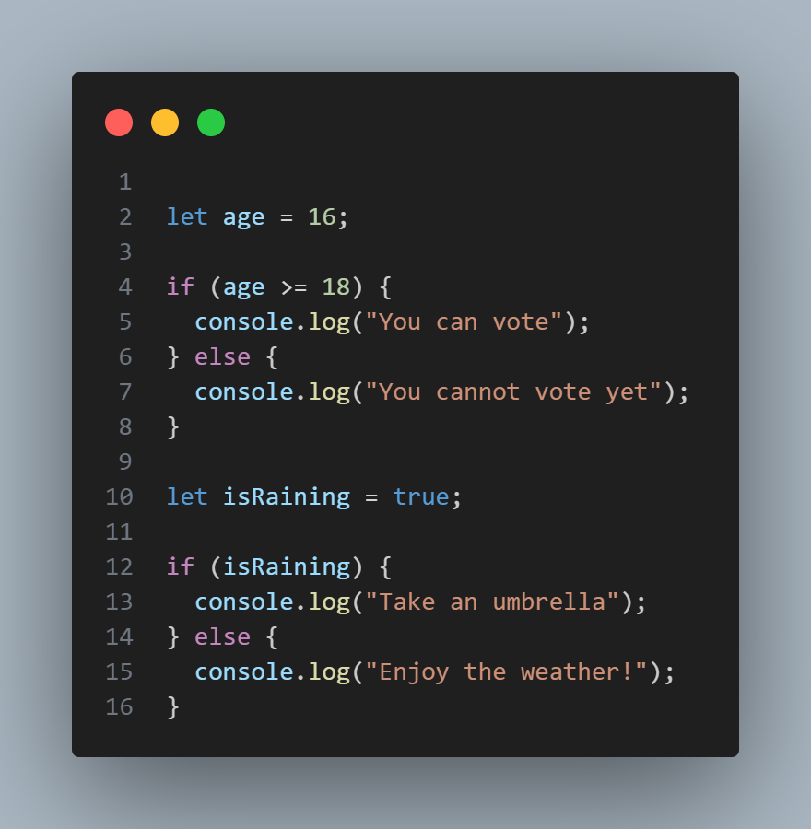
Examples

Slide 7
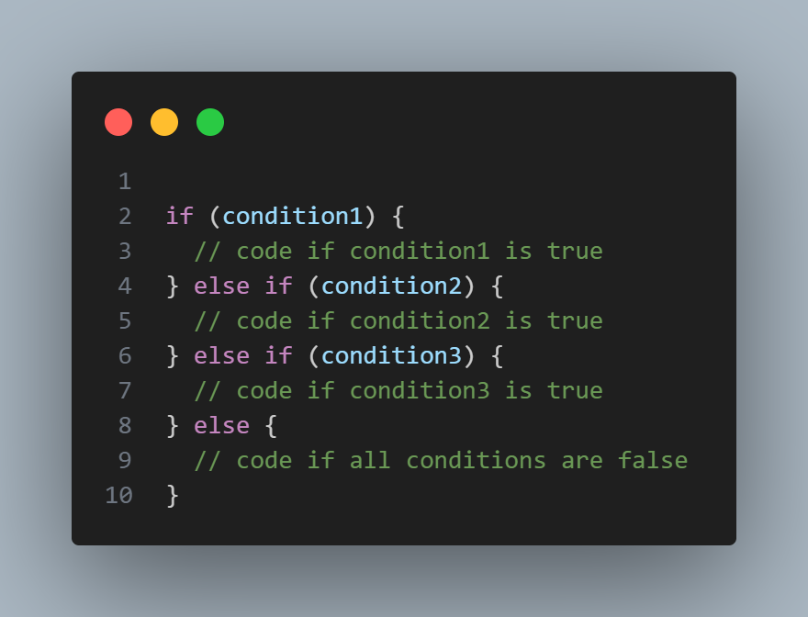
Part 2 cont’d
The ‘else if’ Statement
Check multiple conditions in sequence.
Syntax:

Slide 8
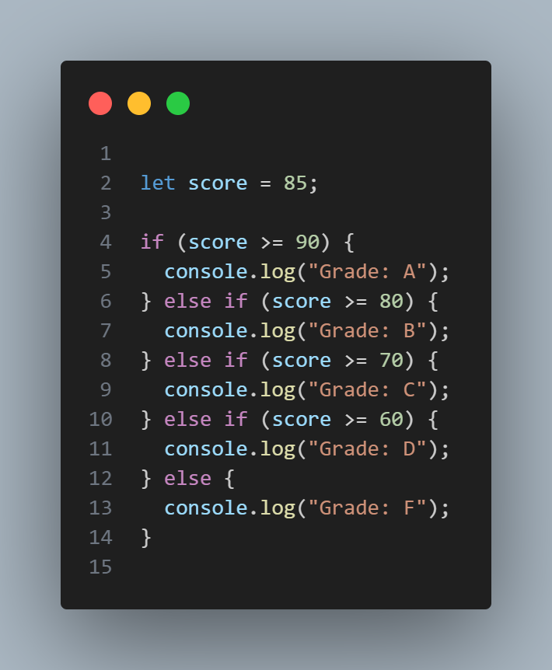
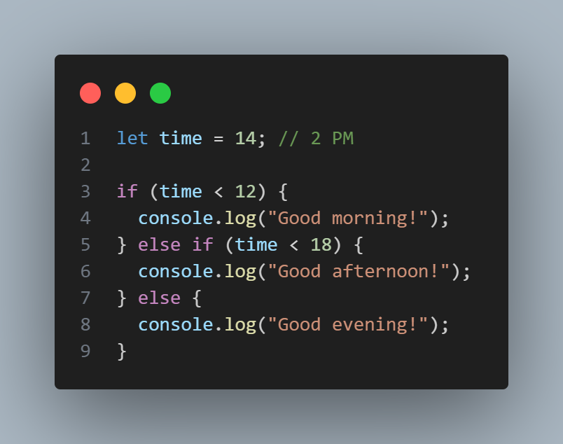
Examples

Slide 9
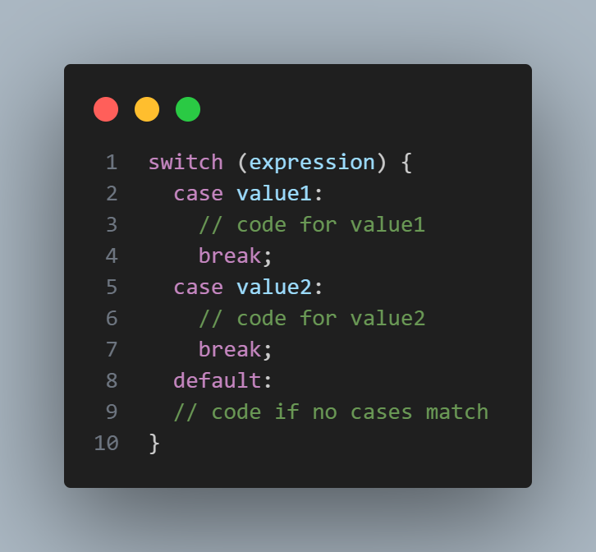
Part 2 cont’d
The ‘switch’ Statement
Alternative to if else statements when checking the same variables against different values.
Syntax:

Slide 10
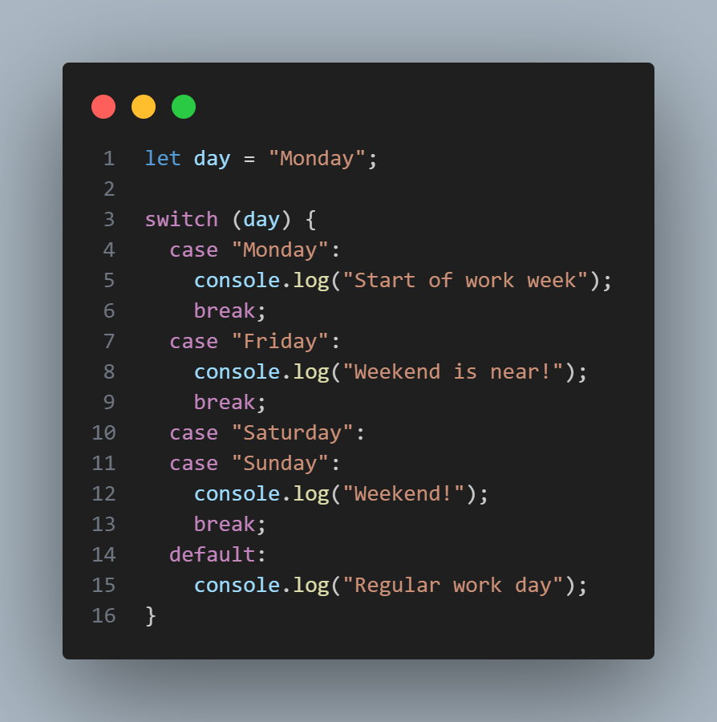
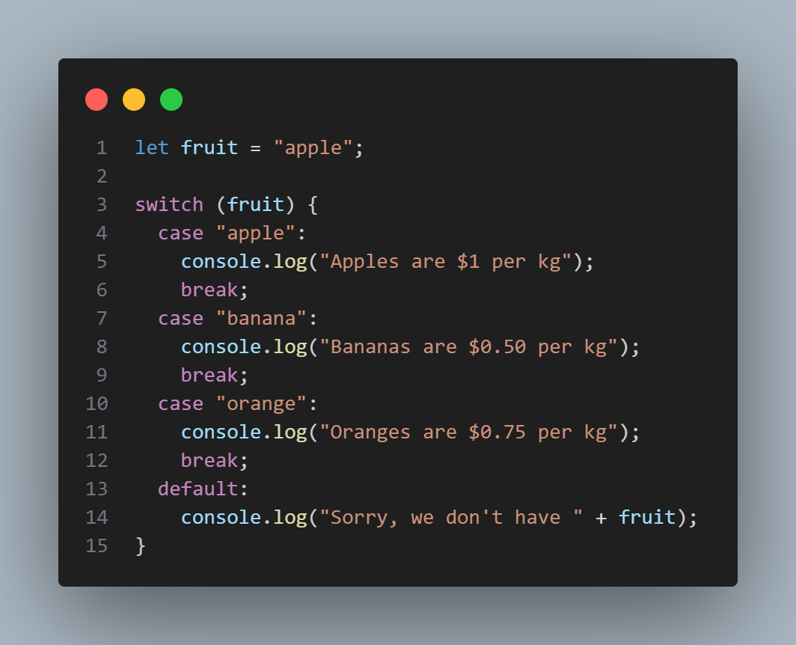
Examples

Slide 11
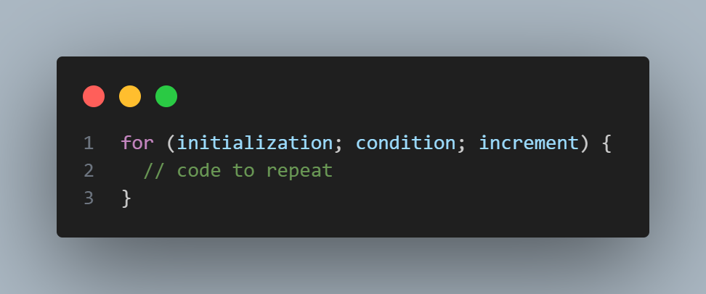
Part 2: Loops
The ‘for’ loop
Use when you know exactly how many times you want to loop.
Syntax:

Slide 12
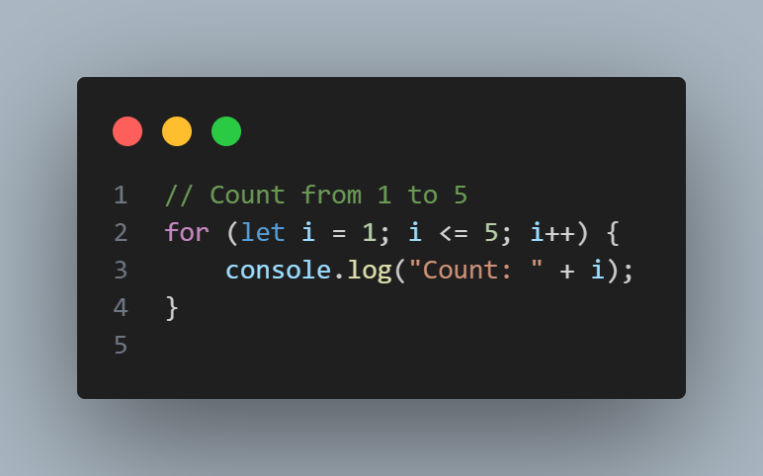
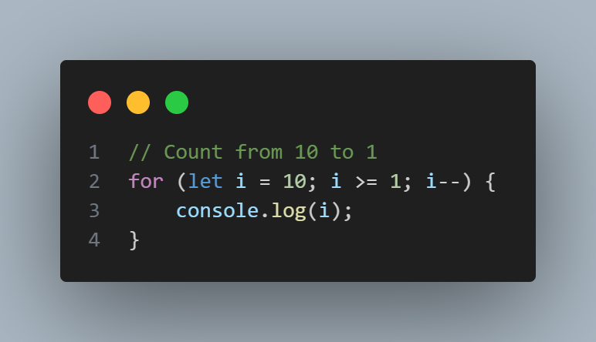
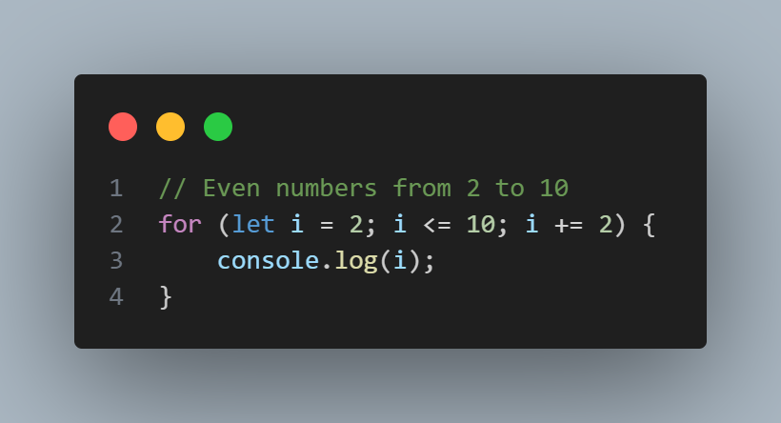
Examples

Slide 13
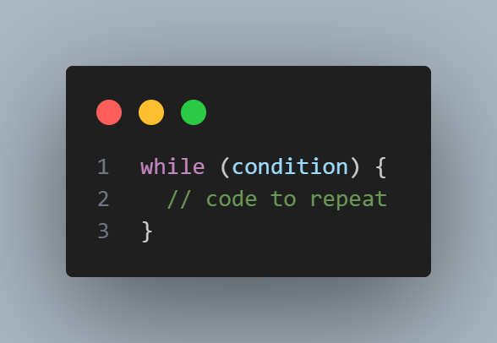
Part 2 cont’d
The ‘while’ loop
Use when you don't know how many times you need to loop, but you know the condition to stop.
Syntax:

Slide 14
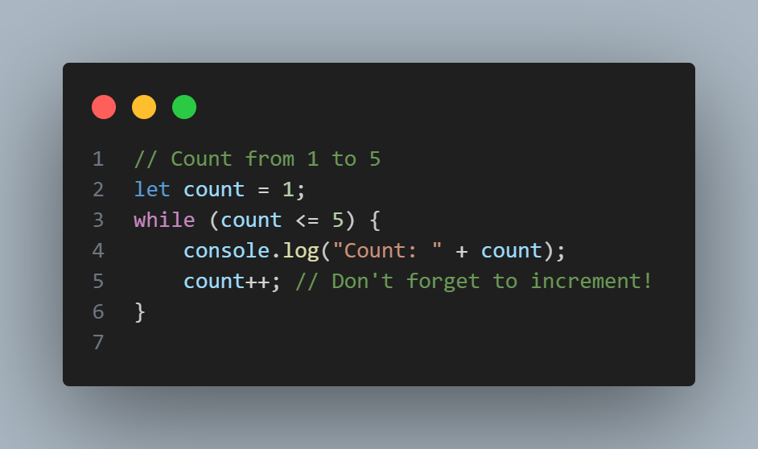
Examples

Slide 15
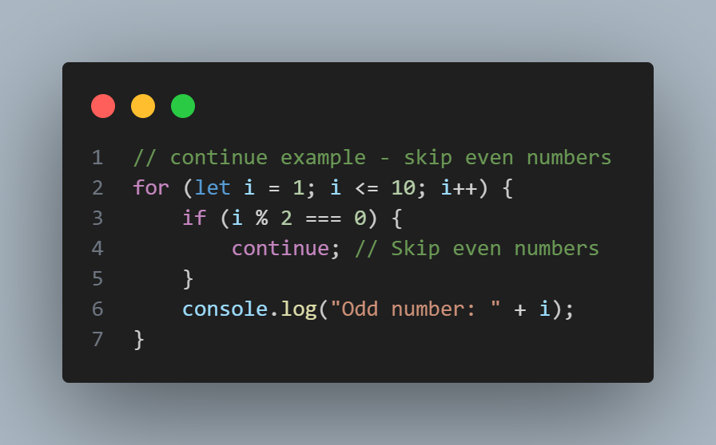
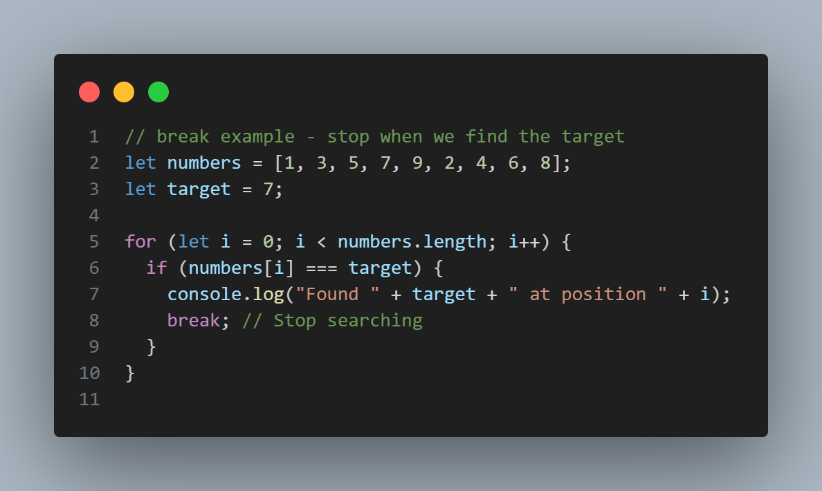
Part 2 cont’d
Loop Control: ‘break’ and ‘continue’
‘break’: Exit the loop immediately
‘continue’: Skip to the next iteration

